Slide 1

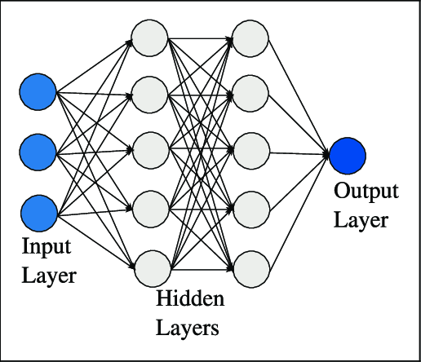
Shale pore pressure prediction using Machine Learning
Tolulope Agbaje

Slide 2
Objective
Build a machine learning model to predict pore pressure using three well logs input
Train model based on data from an exploration well, EI-281.
Apply model to predict pore pressure in an unseen nearby well, EI-298.
Compare prediction to the actual pore pressure in the prediction well.
Apply model to predict pressure in a distant well
Notes:
Accurate prediction of pore pressure helps to increase the likelihood of exploration success and decrease drilling and development costs.

Slide 3
WHY IS THIS IMPORTANT?
Accurate prediction of pore pressure helps to increase the likelihood of exploration success and decrease drilling and development costs.

Slide 4
Methodology
Data Collection
Data cleaning
Data preprocessing
Model training and tuning
Pore pressure prediction

Slide 5
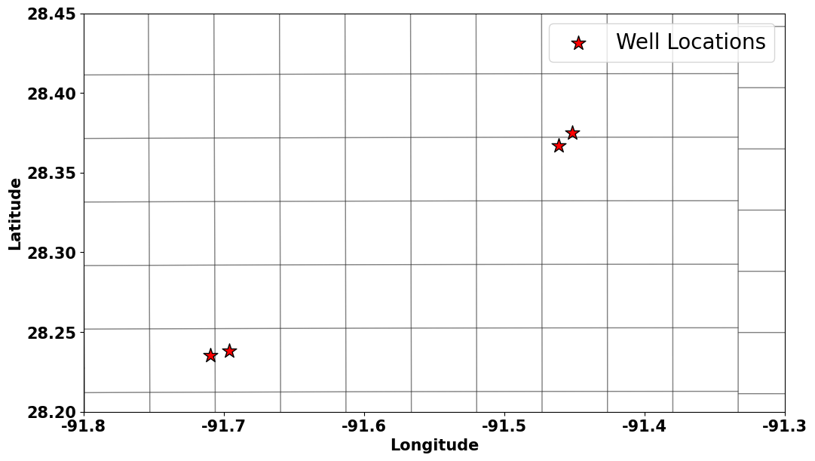
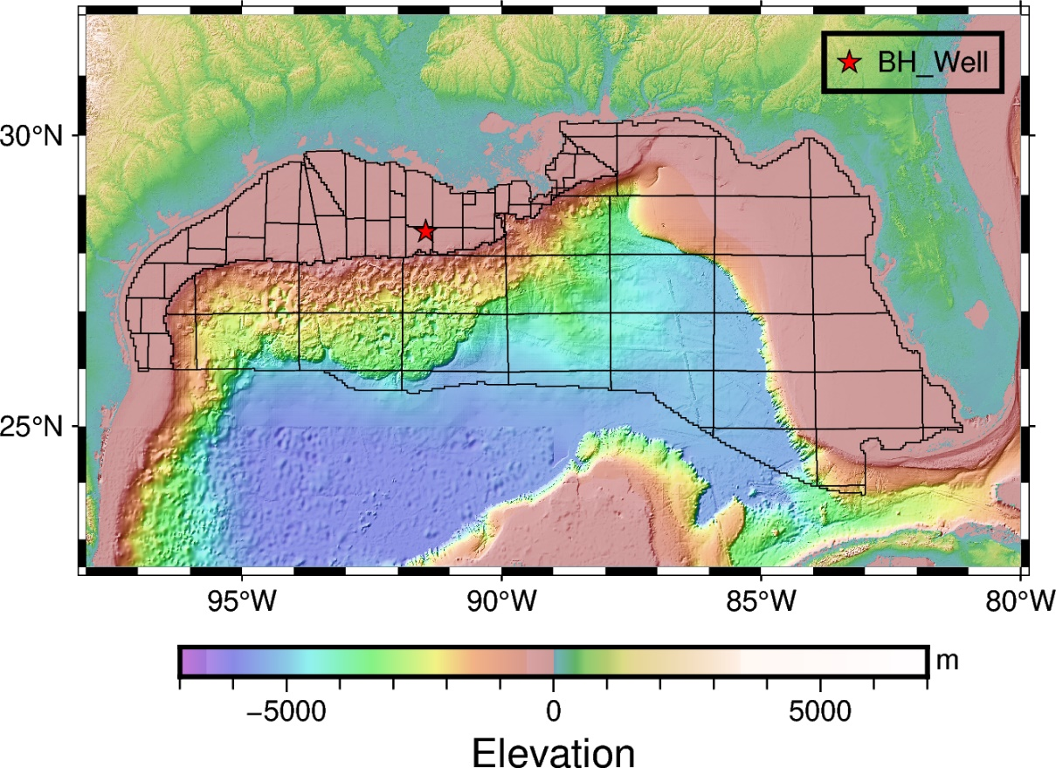
Introduction - Study Area
Wells drilled on the shelf of Gulf of Mexico
Training well
281
298
Prediction well
10 km

Slide 6
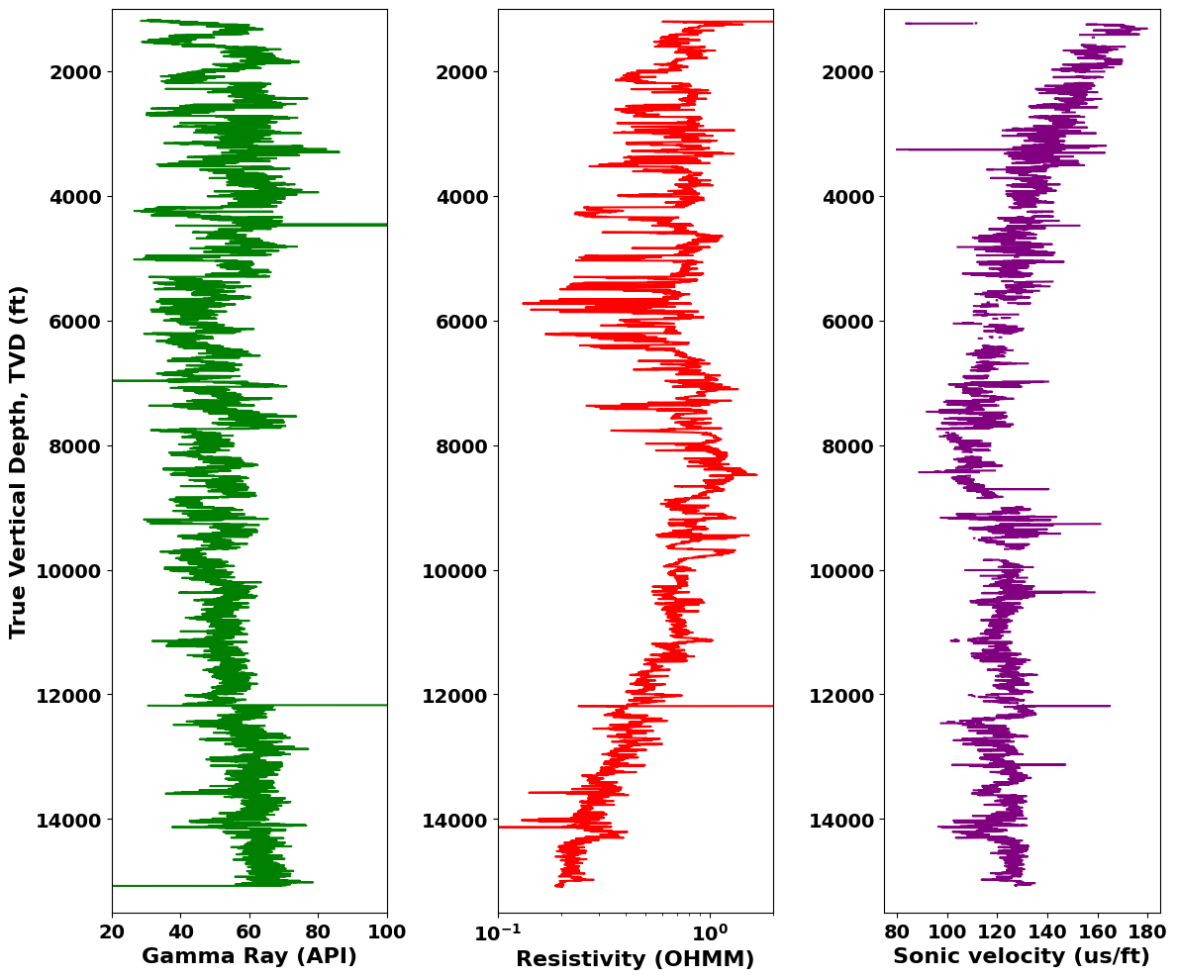
Data – EI 281 (Training well)
Original data from EI-281

Slide 7
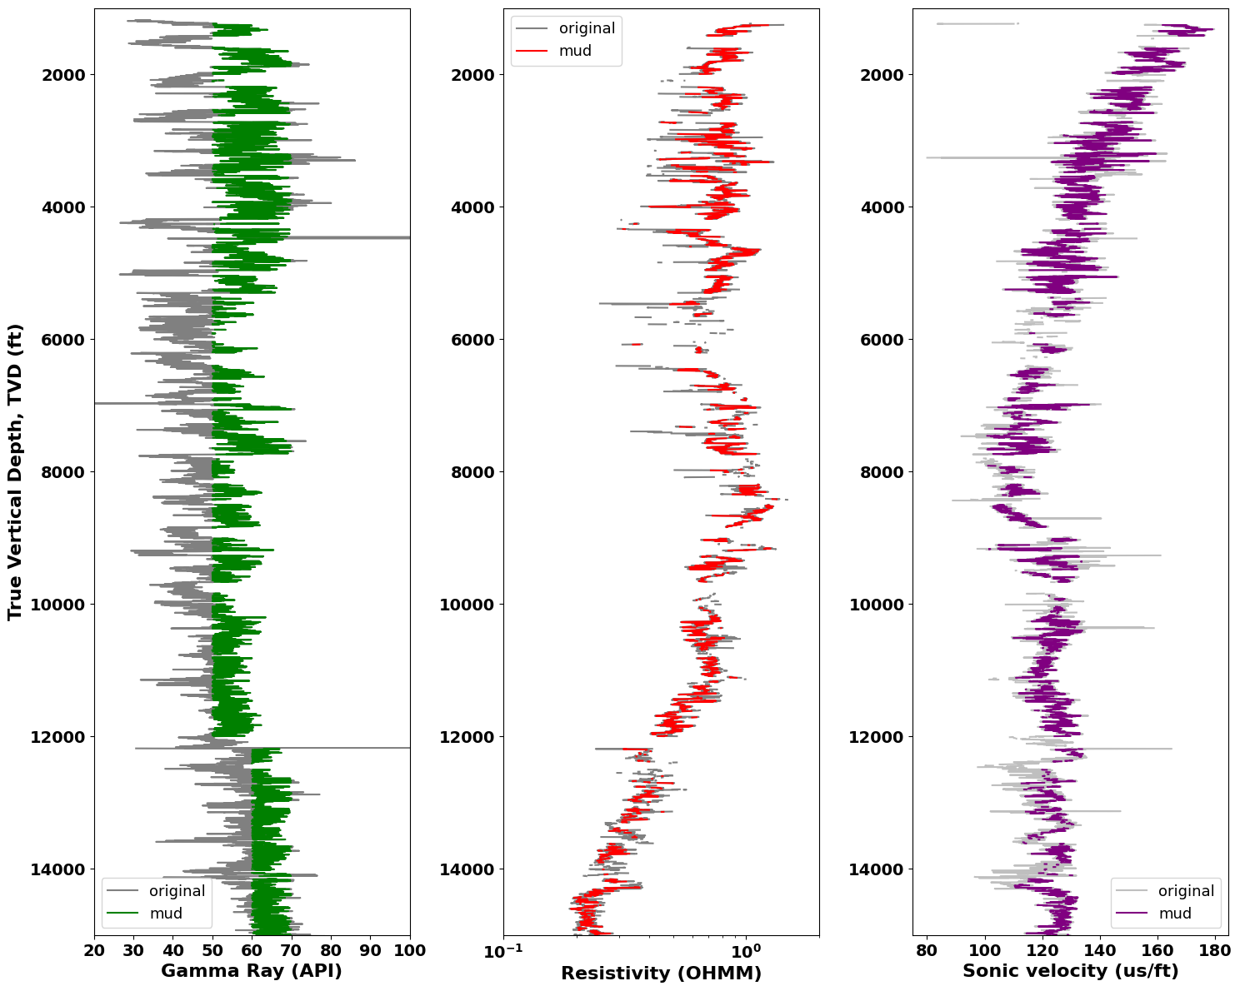
Data Cleaning – EI 281
Mud filtering based on Gamma Ray (GR). Mud cutoff varies along the depth

Slide 8
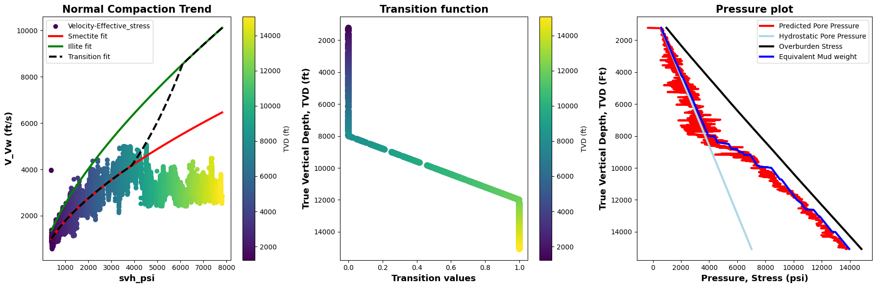
Data preprocessing: EI-281
Pore pressure predicted at EI-281 using the smectite-illite workflow: This helps to have an output for training the ML model
We constrained the NCT for smectitic and illitic rich rocks using the Bowers relationship
Generated a transition function from approximately 8000 – 12000 ft
Applied the Eaton’s approach for the pore pressure prediction

Slide 9
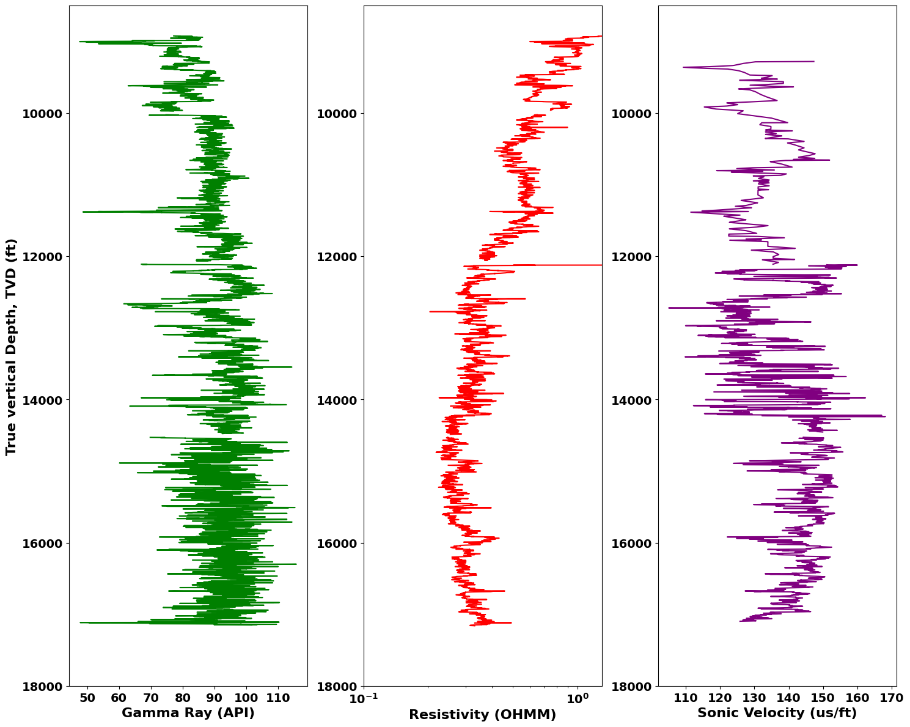
Data – EI 298 (Prediction well)
Original data from EI-298
Logging started at 5050 ft and sonic (dT) started at ~9000 ft

Slide 10
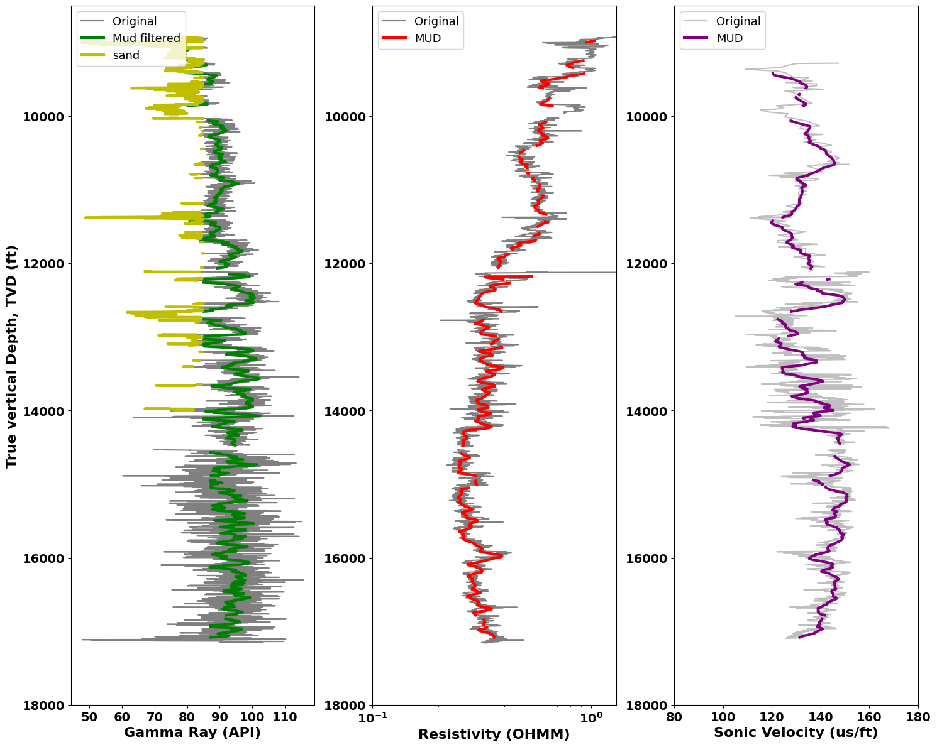
Data Cleaning EI-298
Took running mean of logs to eliminate noise effect using a window size of 30.
Mud filtering using GR. Mud cutoff varies along the depth
Dropped missing values

Slide 11
Model Architecture
Neural networks are computational models composed of interconnected layers of nodes (neurons). Each node receives input, processes it through an activation function, and passes the output to the next layer.
Structure of a Multilayer Perceptron (MLP):
Input Layer: The initial layer that receives input features. Each of the node represents a feature.
Hidden Layers: Intermediate layers between the input and output layers. They extract and transform features through weighted connections and activation functions. The hidden layers could be as many as the problem or quantity of data warrants.
Output Layer: The final layer that produces the network's prediction. The number of nodes depends on the problem type (e.g., regression or classification).
How it works:
Forward Propagation: The input data flows through the network from the input layer to the output layer. Each node in a layer computes a weighted sum of its inputs, applies an activation function, and passes the result to the next layer.
Backpropagation: After computing the output, the network compares it to the actual target value using a loss function. Then, it adjusts the weights and biases of the connections between neurons in a process called backpropagation, aiming to minimize the loss.
Model architecture applied in this study

Slide 12
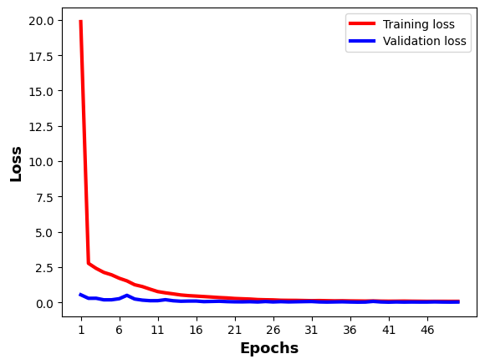
Model training & evaluation
Trained model on data from EI-281
Early convergence using ADAM optimizer
No evidence of overfitting
R2_score = 0.998
MSE = 0.022
Quick convergence

Slide 13
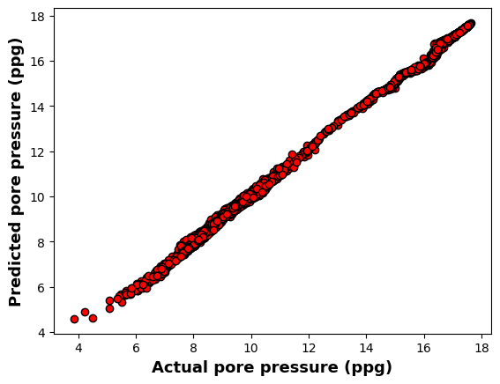
ML pred at EI-281
Set aside 20% of the EI-281 data as validation data to evaluate model performance.

Slide 14
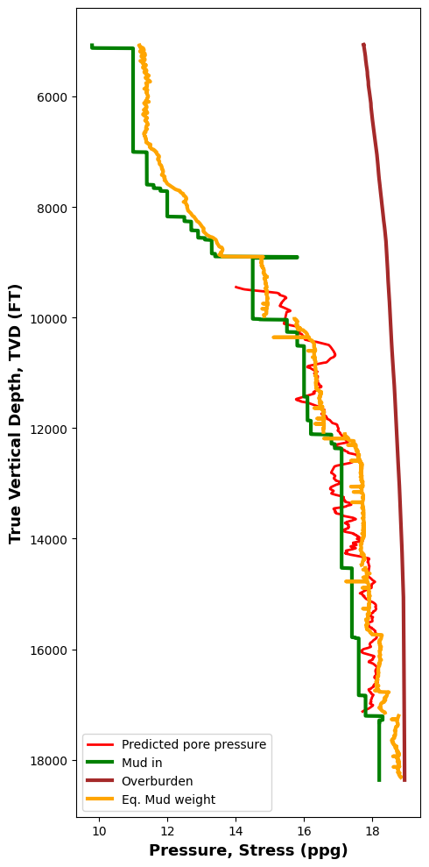
Pore pressure prediction at EI-298
Trained model with data from both hydrostatic and overpressured section of the EI-281 well
Data from EI298 overpressured
Model able to capture the underlying pattern

Slide 15
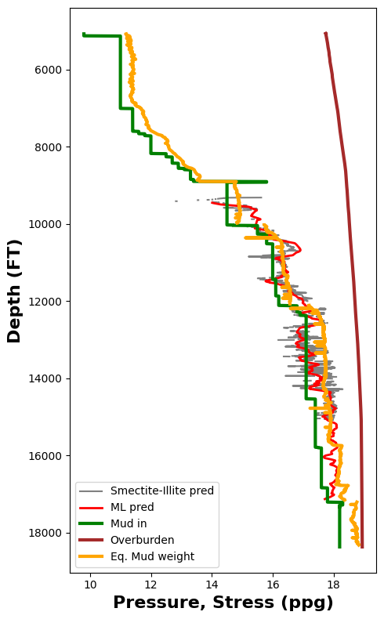
ML comparison with smectite-illite prediction – EI281
Good agreement between the predicted pore pressure using the smectite-illite approach and using ML.

Slide 16
Extending ML prediction to EI-330
Training well
281
298
Prediction wells
330
10 km

Slide 17
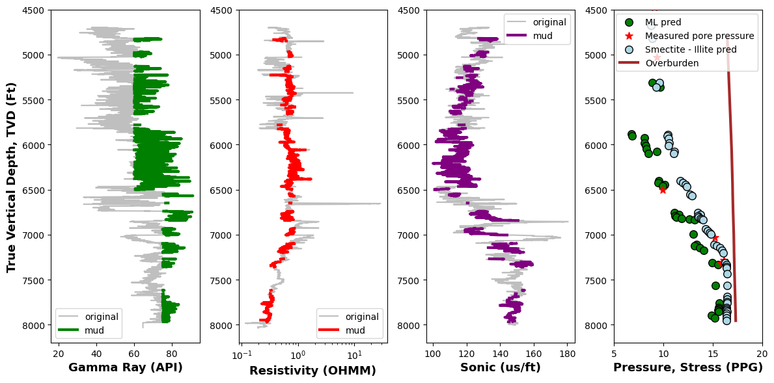
Applied the MLP model to predict pore pressure in the EI-330 well

Slide 18
Good agreement between the predicted pore pressure using ML and the measured pore pressure
Predicted pressure using ML underpredicted
Good agreement between the predicted pore pressure using ML and the measured pore pressure

Slide 19
Conclusion & Thoughts
Machine Learning is a data driven field and the accuracy of result is highly dependent on the quality and quantity of training data.
Pressure prediction at EI-330 not as perfect as prediction at EI-298
EI-298 is a nearby well to the training well, EI-281. The Geology is similar, hence easier for the model to accurately predict the pore pressure
EI-330 Is farther and possibly the Geology of the area is quite different.
Therefore, in order to build a robust model capable of predicting pore pressure across, a block, field, or basin, we need diverse datasets that cover a reasonable portion of the block, field, or basin.
Future work would be geared towards adding more data from other region and observe if the data is able to generalize better.
Also, future work would involve increasing model complexity and adding more features such as drilling data and other engineered features that could improve the performance of the model.

Slide 20
THANK YOU ANY QUESTIONS?

